Slide 1
Use MAX
Data Elements (ISO11179)
Excel spreadsheet ↔ EA roundtrip
From Atlanta 2015 WGM

Slide 2
Spreadsheet
ISO11179 based
Bipolar Spreadsheet as example
ISO11179 based
“Excel” model for Data Elements
(Schema)
MAX
(Schema)
2x XSLT
Sheet “attributes”
– ID
– Category (dropdown “classes” sheet)
– Data Element Name
– Definition
– Permissible Values (dropdown “enums” sheet)
– Data Type (fixed list)
– ...
Sheet “classes”
– ID
– Name
– Definition
valuesets and datatypes
Sheet “valuedomains”
– ID
– Name
– Delimited Values
add attribute @id !
so MAX can update attirubtes

Slide 3
ISO 11179
Object_Class (class) has Data_Elements (attributes)
Data Element is concrete version of generic Property
  if Object_Class = “Person” and Property = “Age” a Data_Element is the Age of a Person
  is part of Object_Class
  has Value_Domain for values
Value_Domain has datatype
  specific Enumerated_Value_Domain with Permissible_Values
  or Described_Value_Domain
http://standards.iso.org/ittf/PubliclyAvailableStandards/c050340_ISO_IEC_11179-3_2013.zip

Slide 4
ISO 11179-3 Registry Metamodel based
Excel file
XML file
MAX file
3 Sheets
model for Data Elements
(Schema)
MAX
(Schema)
Developer
tab Excel
XSLT (2)
Excel Sheets and columns
Sheet “data_element”
– ID
– Category (dropdown “object_type”)
– Data_Element Name
– Definition
– Value Domain (dropdown “value_domains”)
Sheet “object_type”
– ID
– Name
– Definition
valuesets and datatypes
Sheet “value_domain”
– ID
– Name
– Datatype
– Permissible Values
add attribute @id !
so MAX can update attirubtes

Slide 5
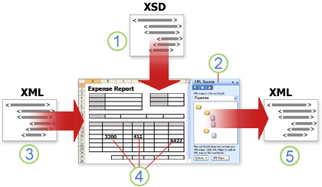
Excel XML background
https://support.office.com/en-sg/article/Overview-of-XML-in-Excel-f11faa7e-63ae-4166-b3ac-c9e9752a7d80

Slide 6
Make spreadsheet XML/MAX compatible
Create spreadsheet and XML map left to right all columns to MAXSchema(_dataelement).xsd
Insert extra columns that are in the source spreadsheet
  Then export works with not mapped columns, if you insert extra columns before mapping the export wo'nt work.
Remove merged cells / rows
Paste in all cells values only ctrl-alt-v
Change header labels
Re-apply any formatting (don't do merge cells etc)
–----
Import in EA, create diagram and add relationships, they stay in when update is done!
N.B. Use ValueSetName as DataType!
No need for the ValueSetName column.
Spaces are allowed!
Issue: Update in EA gives Exception. Update of attributes seems to be the problem. WORKAROUND implemented

Slide 7
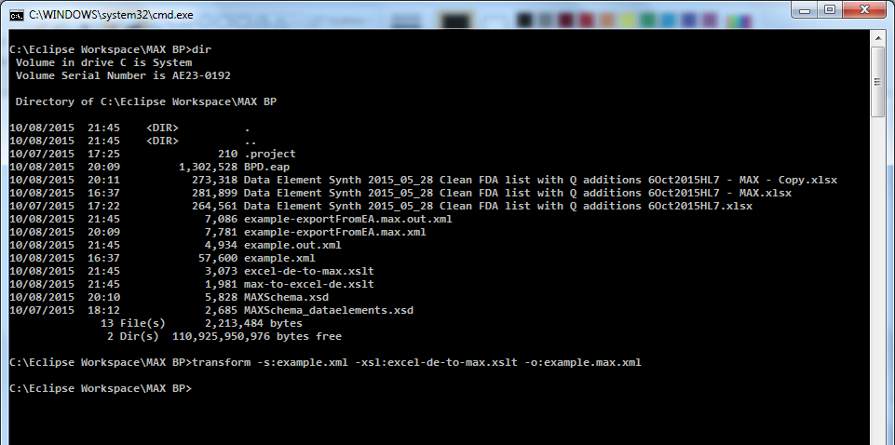
MAX (cont)
Open a cmd-line
  MAX requires SAXON9.NET so you have command line tools available to work with XML / XSLT!
From excel to max
  Transform -s:bpd.xml -xsl:excel-de-to-max.xslt -o:bpd.max.xml
From max back to excel
  Transform -s:bpd.max.xml -xsl:max-to-excel-de.xlst -o bpd.xml

